Slide 1
Blackjack.ACE
- Powered by Java
Group Members:
Tian Yuan (Daisy)
Xijia Zeng (Jay)
Sihui Lyu (Sharon)
Qiannan Shi (Maggie)

Slide 2
Agenda
Goals and Rationale
Demonstration of the Project
Methodology
Ideas from Object Oriented Design
Findings and Lessons Learned
Limitations and Future Works
Reference

Slide 3
Goals and Rationale
Rationale
Chose Blackjack for its popularity, simple rules, and alignment with our team’s shared interest in card games [1]
Goals
Implement core game logic and interactive gameplay using Java
Apply object-oriented programming (OOP) principles by modeling real-world entities like cards, players, and the dealer

Slide 4
Demonstration of the Project
Overview of Blackjack Game Rules:
Player competes against the dealer to get a hand value as close to 21 as possible without exceeding it.
Number cards count as their face value; face cards (Jack, Queen, King) are worth 10; Aces can be counted as 1 or 11, whichever benefits the hand without causing a bust.
Player starts with two cards and can choose to “hit” (take another card) or “stand” (keep current hand). Dealer’s first card is visible.
If a player’s hand exceeds 21, he “busts” and loses. The player wins by having a higher hand than the dealer without busting or if the dealer busts.

Slide 5
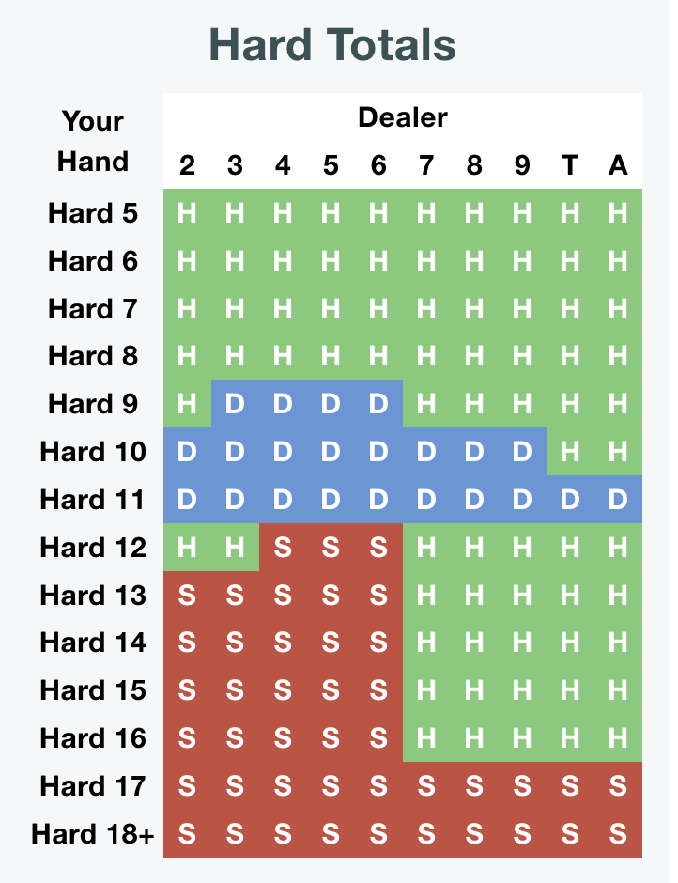
Basic Strategy Card
It is generated through mathematical simulation and probability analysis. It’s essentially a table that tells you the statistically optimal action (hit, stand, double, split, etc.) based on:
Your current hand total
The dealer’s visible card
Whether you have a usable ace or not (soft hand)
[2]
Notes:
In the traditional way, the player will rely on a basic strategy

Slide 6
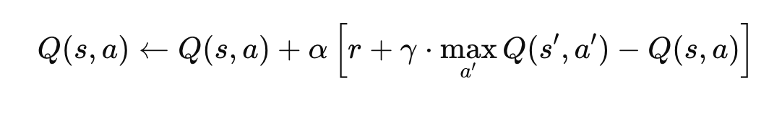
Q-Learning
Reinforcement learning algorithm
A type of machine learning where an agent learns to make decisions by interacting with an environment, aiming to maximize a cumulative reward over time.
[3]
Notes:
Q(s,a): current Q-value for state sss and action aaa
α\alphaα: learning rate (how much new info overrides old)
rrr: reward received after taking action aaa in state sss
γ\gammaγ: discount factor (importance of future rewards)
max⁡a′Q(s′,a′)\max_{a'} Q(s', a')maxa′​Q(s′,a′): estimated value of the best action from the next state s′s's′
Update the value of doing action aaa in state sss based on the immediate reward and the estimated future value from the next state.

Slide 7
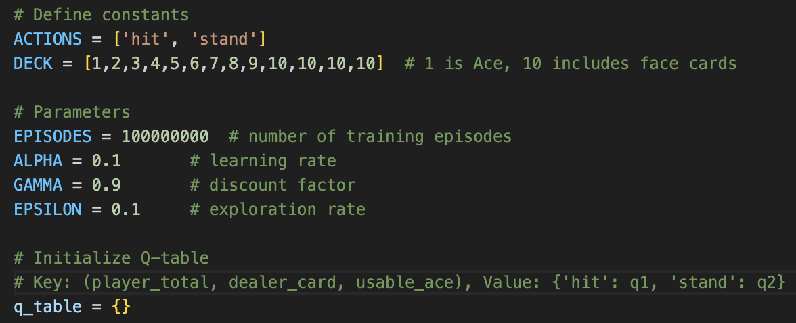
Q-Learning Implementation
Notes:
Alpha: Controls how much new experience overrides old knowledge.
If the AI decides to Hit with 17 and gets a reward (e.g., loses the game), alpha determines how much the Q-table is updated for that decision.
Low alpha → learning is slow and stable. High alpha → fast learning, but can be unstable.
In blackjack: Each time the agent plays a hand and learns whether it won or lost, alpha controls how much it trusts that outcome.
Gamma (γ) – Discount Factor
Determines the importance of future rewards vs. immediate rewards.
A high gamma means the agent considers the long-term reward of actions (good for multi-step games).
A low gamma makes it short-sighted.
In blackjack: Even though the reward only comes at the end (win/lose), gamma helps the agent understand that current decisions influence final outcomes. So it values smart early moves (like not hitting too aggressively).
3. Epsilon (ε) – Exploration Rate
Controls exploration vs. exploitation.
With probability ε, the agent chooses a random action (exploration).
With probability 1–ε, it chooses the best known action (exploitation).
In blackjack: At the start, the AI explores wildly (random hit/stand). As it trains (500,000 episodes), epsilon decays → the AI exploits what it has learned from the Q-table.
We wrote card functions, game rules, and training to loop through the episodes and stored the results in the q table.

Slide 8
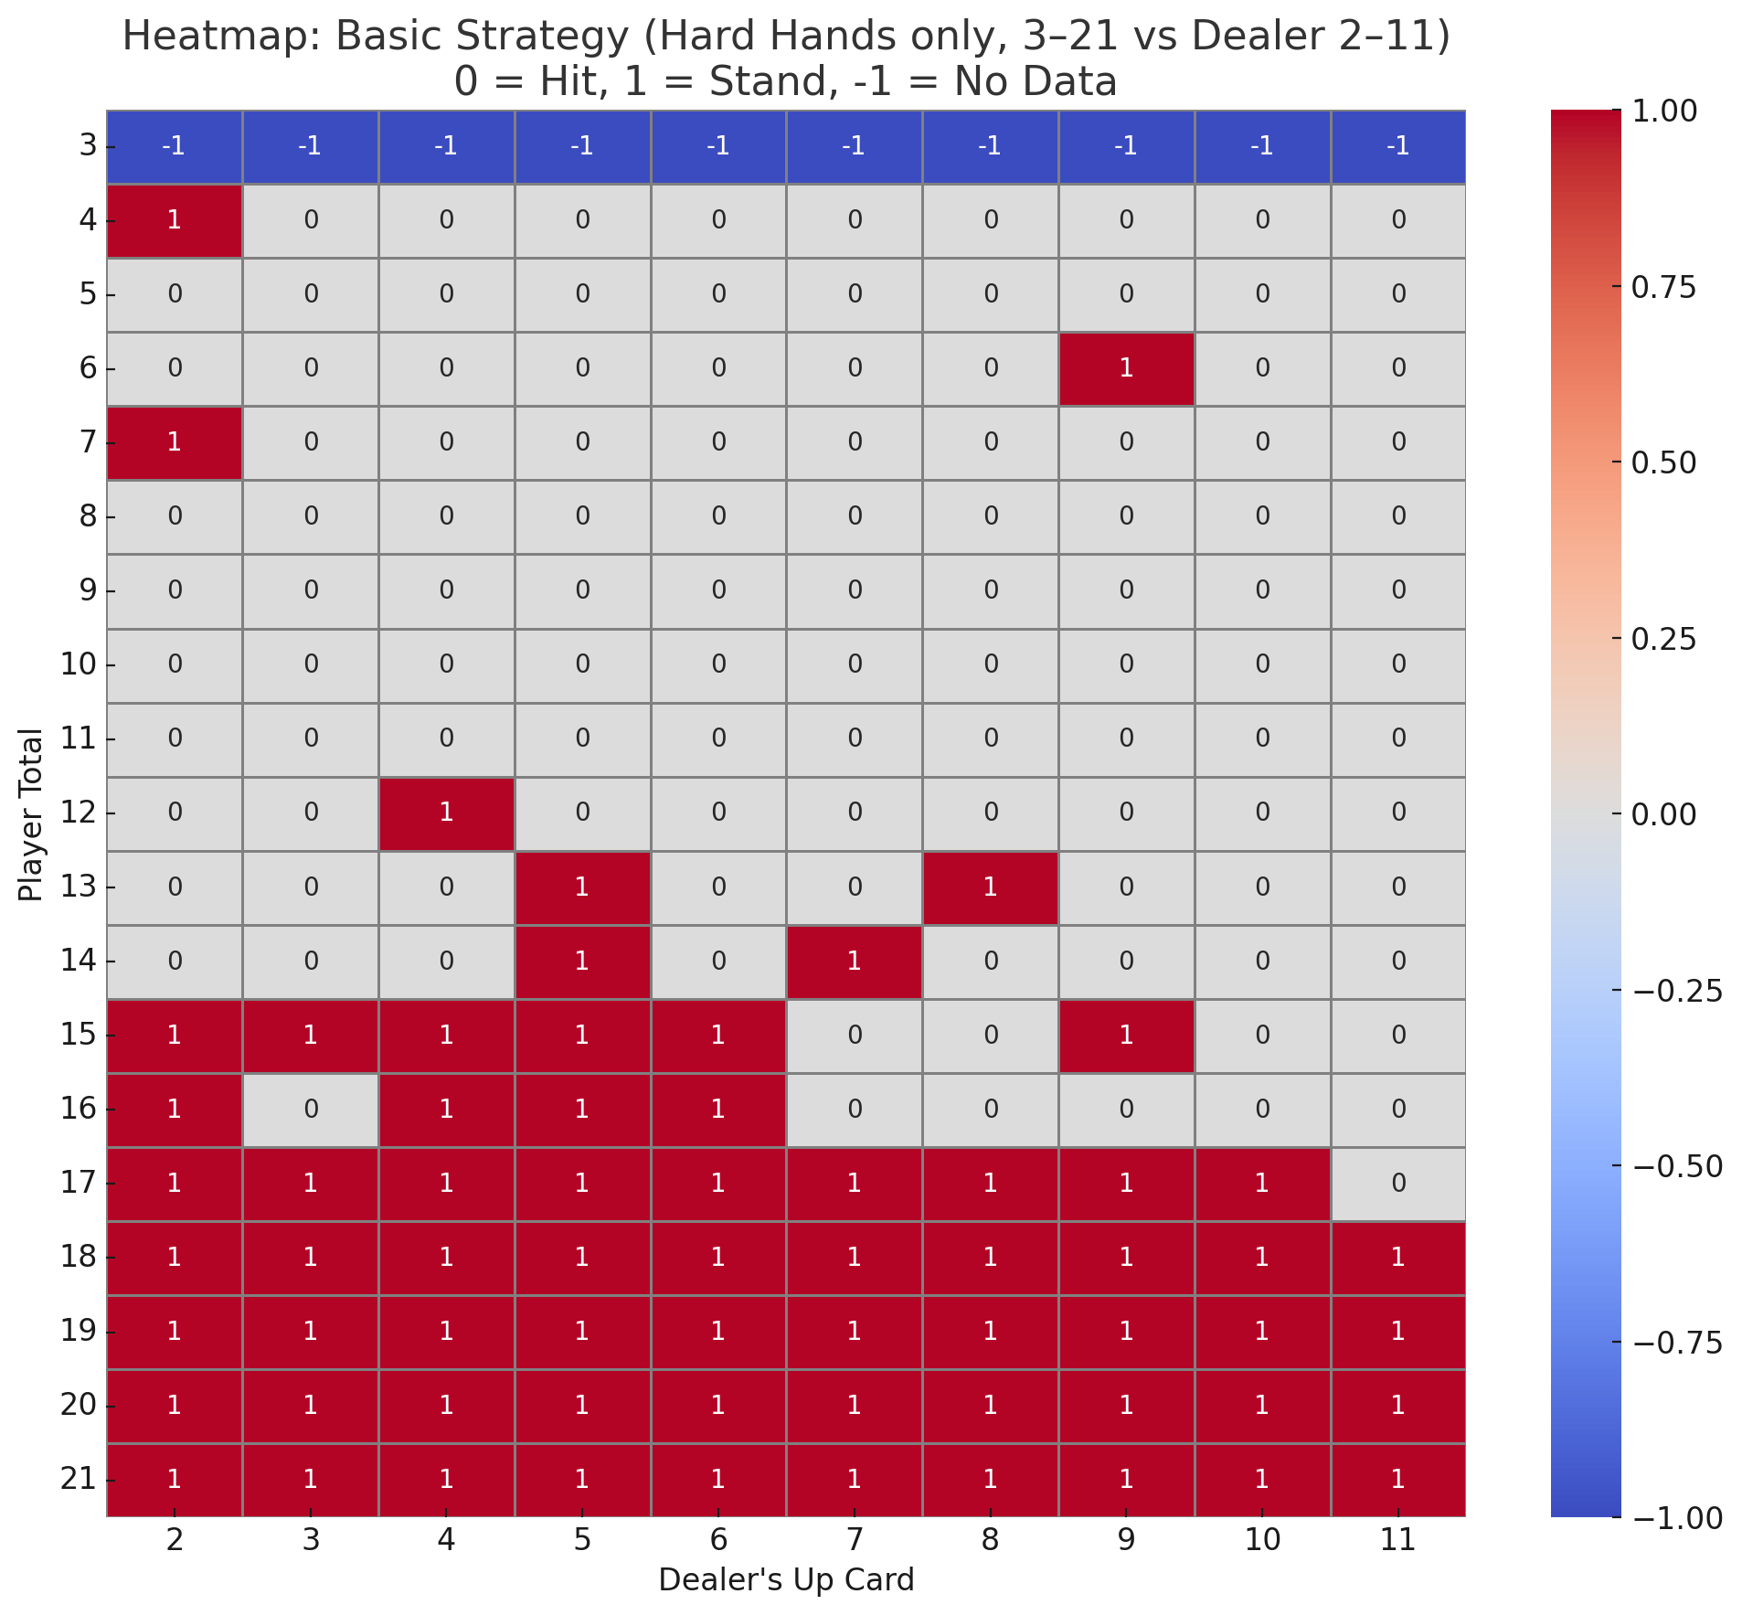
Q-Learning Heatmap vs Basic Strategy Card
Notes:
similar trends confirms and assures us that the q learning actually works.

Slide 9
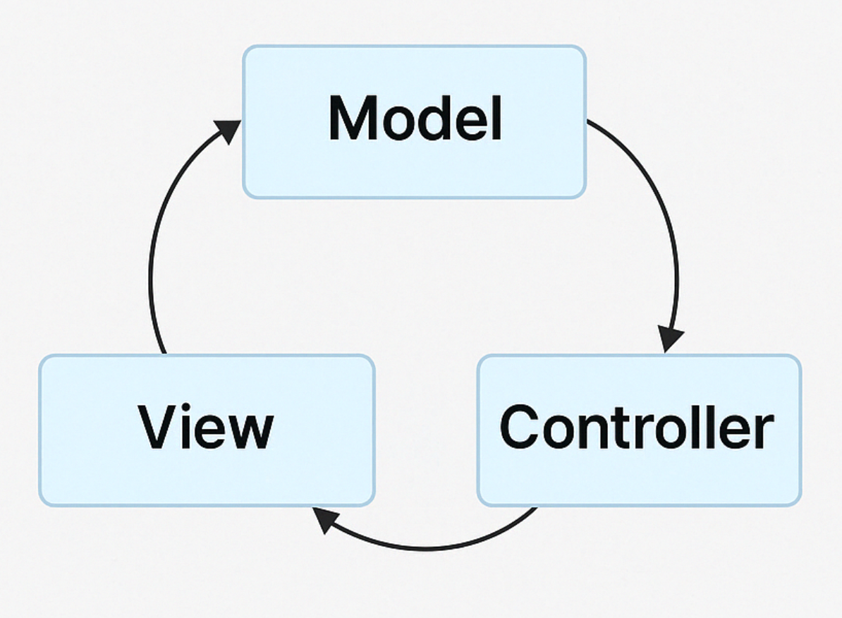
Methodology - MVC Architecture
Model: contains all the core game logic and data (e.g. scoring, card drawing and game state transitions)
View: handles the GUI, rendering card images and control buttons.
Controller: listens to user inputs and updates both the model and the view accordingly.
more modular, testable, and easier to maintain
Notes:
Let me introduce the methodology part, our project uses MVC Architecture stands for Model, View, and Controller — and here’s how each part works in our project. This structure makes our application more modular, testable, and easier to maintain. I will focus on the model part

Slide 10
Methodology - Model Overview
Model
BlackjackGame
Player
Dealer
Deck
Card
AIAdvisor (Q-table)
AudioPlayer
(BGM handler)
BlackjackGame: Manages game state and flow (reset, getPlayerState)
Player & Dealer: Track hands, scores, and rules for hitting/standing
Deck: Shuffles and deals cards
Card: Holds value, suit, and image path for GUI rendering
AIAdvisor: Loads Q-table and returns optimal move
AudioPlayer: Plays background music, supports play/stop methods
Notes:
Here’s a breakdown of the Model layer. You can see it consists of 7 classes.

Slide 11
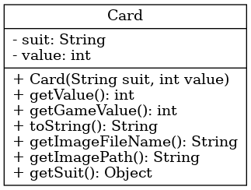
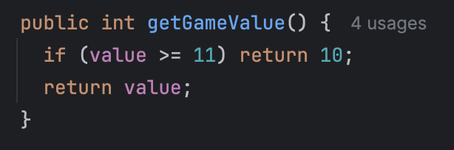
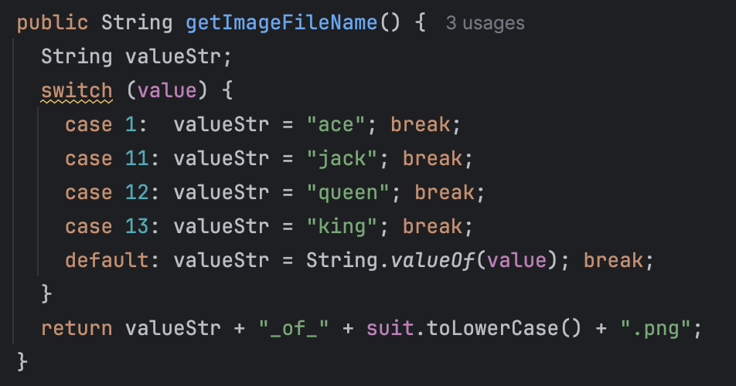
Methodology - class overview
Returns value for Blackjack rules:
Note: J, Q, and K are worth 10 points
Returns relative path for GUI image rendering
(e.g.,"assets/cards/jack_of_hearts.png")

Slide 12
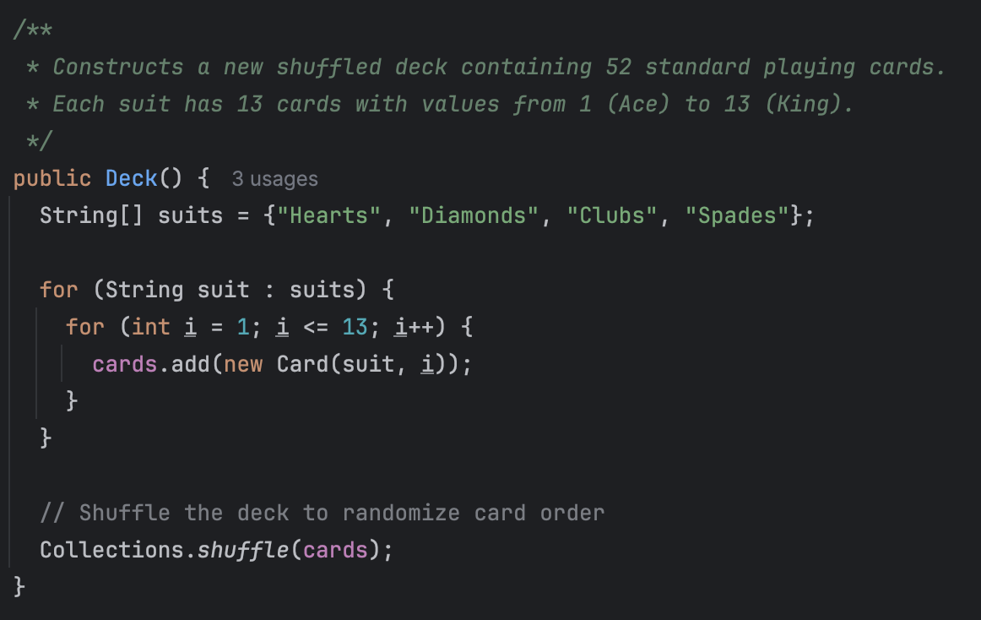
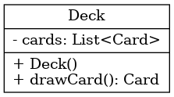
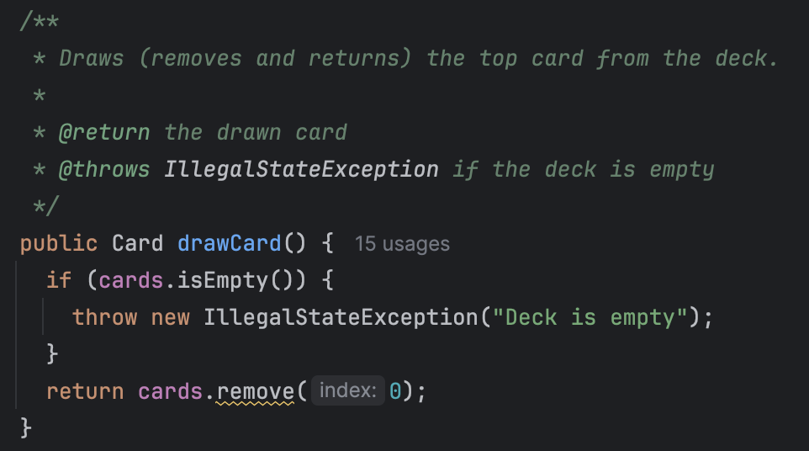
Methodology - class overview
● Deck(): Initializes 52 cards from 4 suits and values 1–13
● Collections.shuffle() ensures randomness
Removes and returns the top card
Throws exception if deck is empty

Slide 13
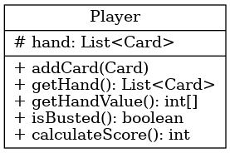
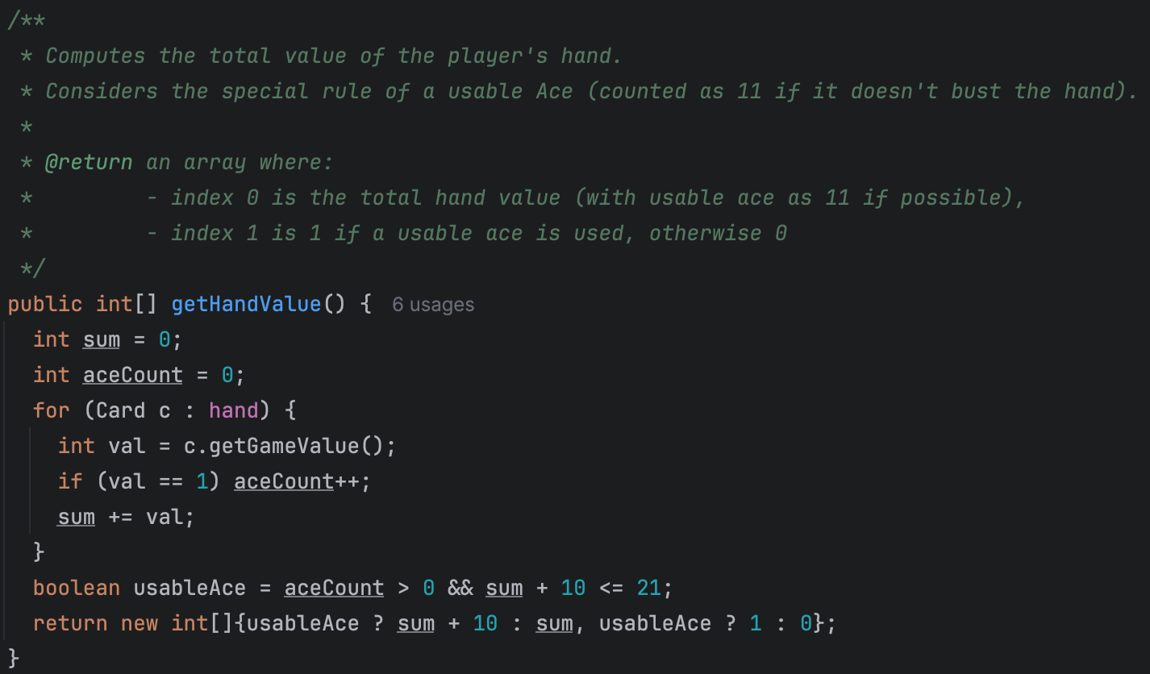
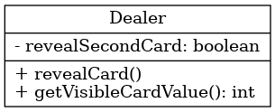
Methodology - class overview
Scoring Logic with Usable Ace Handling
Calculates the total value of the player's hand
Counts Aces and determines if one can be used as 11 without busting
Applies 'usable Ace' logic to maximize the score
Returns a two-element array:
Index 0: total hand value (with Ace as 11 if possible)
Index 1: flag for usable Ace (1 = usable, 0 = not usable)
The Dealer class extends Player class to add dealer specific behaviors
revealCard():
toggle the hidden second card
getVisibleCardValue() :
expose the visible card's value for player decision-making

Slide 14
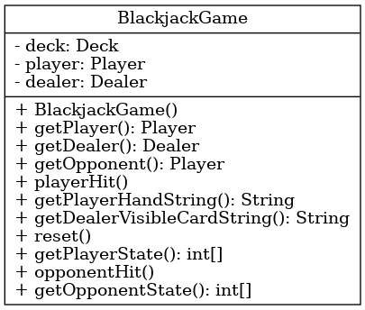
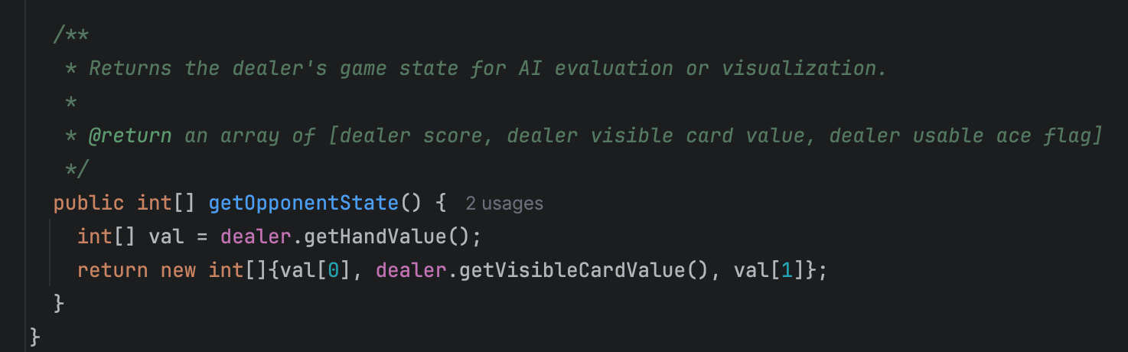
Methodology - class overview
Encapsulates full game state: Deck, Player, Dealer
Public APIs for game control: playerHit(), opponentHit(), reset()
Provides state arrays for AI logic: getPlayerState(), getOpponentState()
Supports GUI with string representations (e.g., getPlayerHandString())

Slide 15
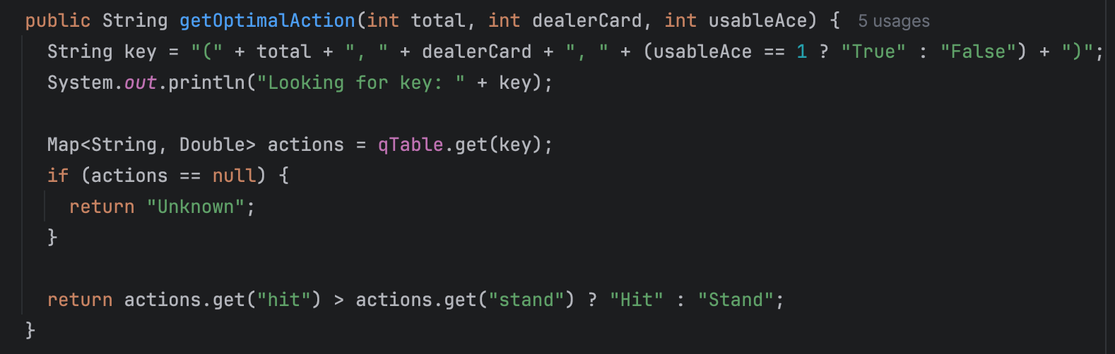
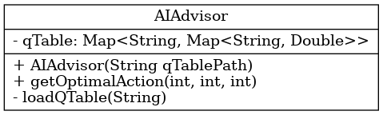
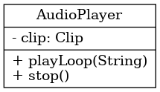
Methodology - class overview
This method converts the current state to a string key and queries the Q-table.
Plays background music, supports play/stop methods

Slide 16
Methodology

Slide 17
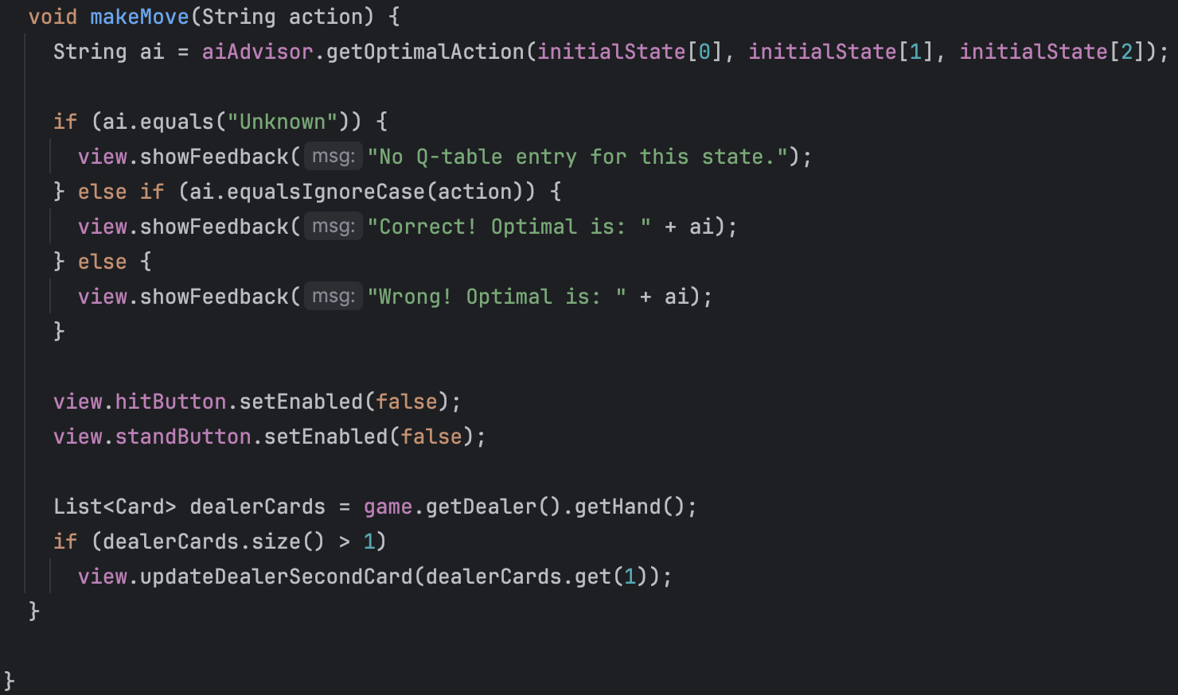
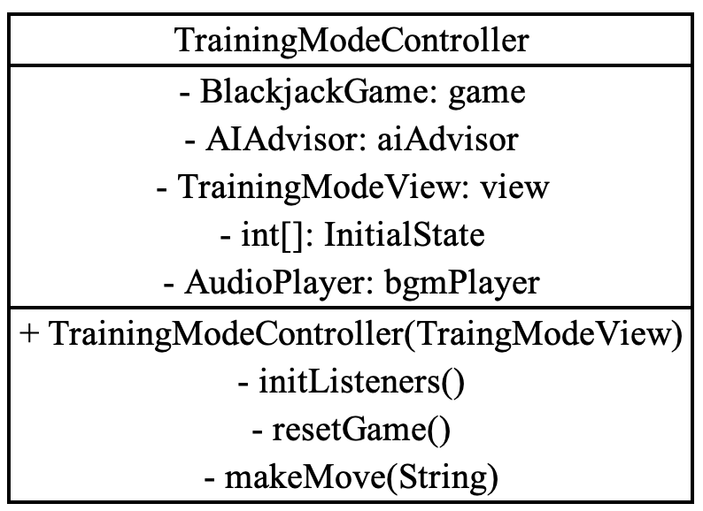
Methodology - Class overview
Compare player action against AI optimal action and display recommended action message according to pre-loaded Q-table
Notes:
The main logic in this mode is for players to make a hit or stand decision based on score of players given cards and one of dealers card
and our AI agent will help check if players decision is optimal according to the Q-table

Slide 18
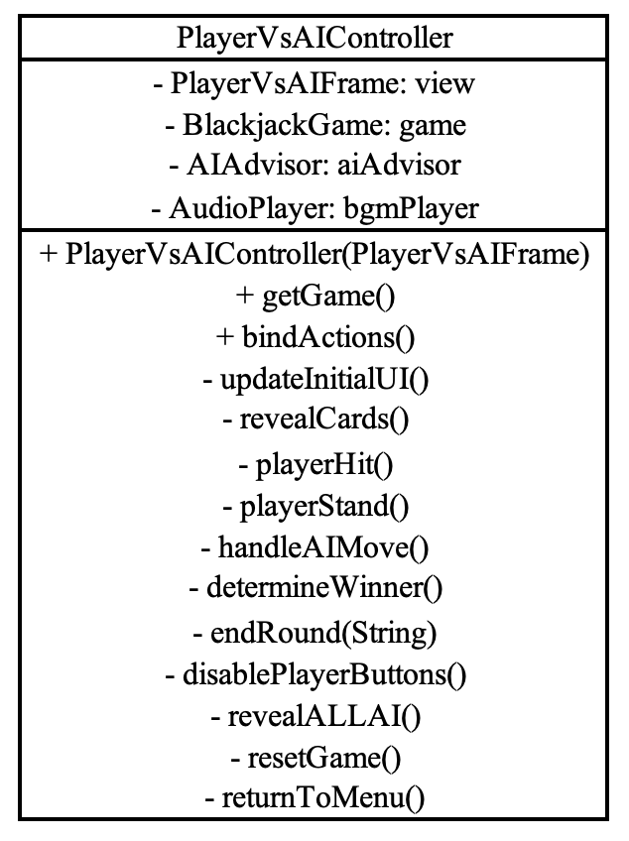
Methodology - Class overview
Manage player’s action
Hit: draw cards for player, and end round if player busts
Stand: player stops drawing new cards and triggers AI move
Manage AI’s action
Get decisions via looking up q-table, repeat hit until it decides to stand or busts
Determine winner
Compare dealer and player score and set corresponding result message
Notes:
This another controller class for our versus mode. so the difference between our training and versus mode is we no longer make a decision to just hit or stand instead we have to decide when to stand or face the risk of busting. After players action, it comes to agents move, handleAImove method will let the agent decide to hit or stand based on itsknowledge base. If neither of player or agent busts, method determineWinner will compare players and dealers score and display result message

Slide 19
Methodology

Slide 20
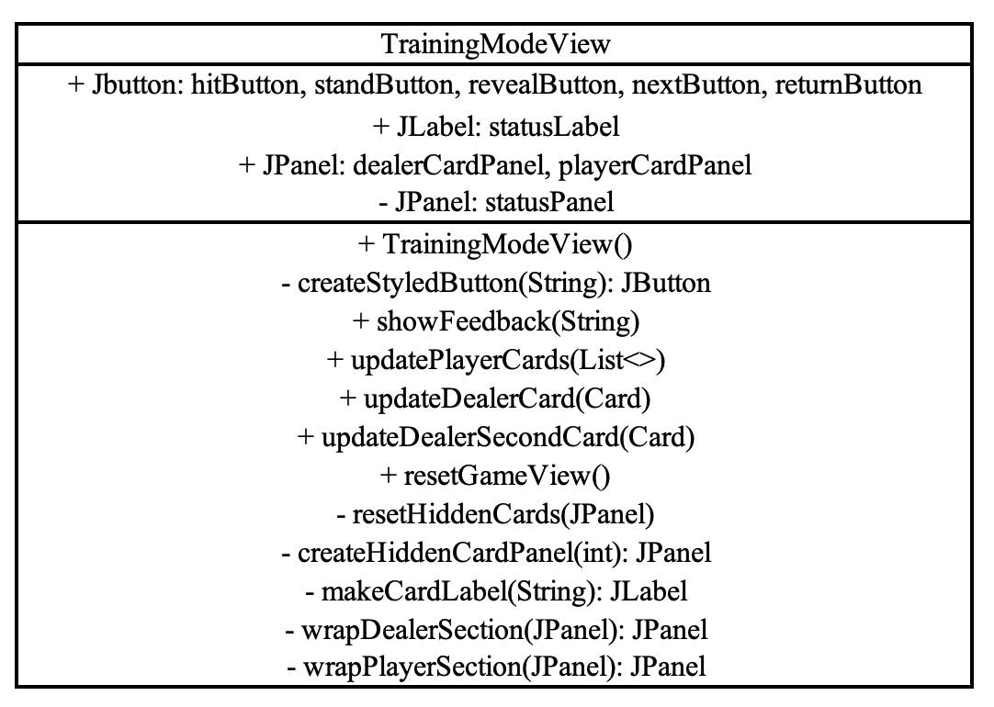
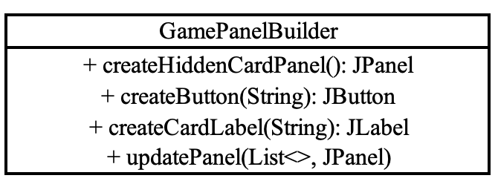
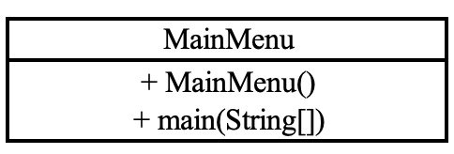
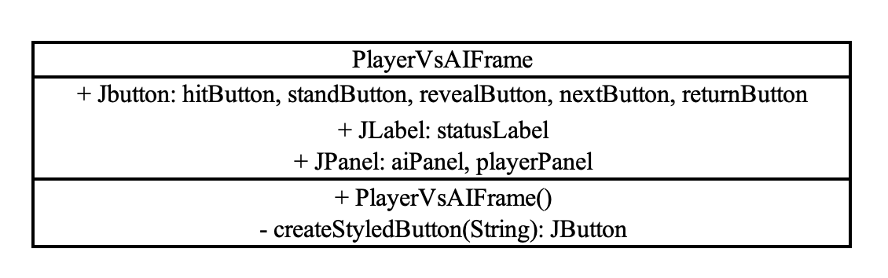
Notes:
These 4 classes constitute the view/GUI of this application, it receives inputs from users and processes with model logic and updates underlying state, and outputs corresponding actions
TrainingMdoeView and PlayerVsAIFrame are designed for trainingMode and versusMode respectively
GamePanelBuilder: helper utility class for reusable panels and buttons, ensure consistent UI creation

Slide 21
Object Oriented Design Principles
MVC architecture
Model: Core game logic
View: Game window, displaying cards, state, and buttons
Controller: User interaction
Inheritance
E.g.: Dealer class inherits from player class, acting similar but includes dealer-specfic behavior
Composition over inheritance
E.g.: BlackjackGame class contains and delegates behaviors to class Deck, Dealer, and Player rather than inheritance
Encapsulation
Properties encapsulated, access and interaction through public methods only to avoid unintended changes and maintain integrity

Slide 22
Findings and Lessons Learned
Separating logic into loosely coupled components (eg.MVC+AI) easier to debug, extend, and test our code.
Q-Learning converges to solid policy with enough training.
Q-table and basic rule conflicts in vs mode.

Slide 23
Limitations & Future Work
No splitting, doubling down, or betting strategies.
Add support for splitting, doubling down.
Implement betting and money tracking.
When the agent encounters a state that was rare during training, the Q-value might be missing or inaccurate, leading to suboptimal decisions.
Explore deep Q-networks (DQN) for larger state spaces.
Notes:
When your agent encounters a state that was rare during training, the Q-value might be missing or inaccurate, leading to suboptimal decisions.

Slide 24
Reference
[1] Zimran, A., Klis, A.A., Fuster, A., & Rivelli, C. (2009). The Game of Blackjack and Analysis of Counting Cards.
[2] BlackjackInfo. (n.d.). Blackjack basic strategy engine. Retrieved April 21, 2025, from https://www.blackjackinfo.com/blackjack-basic-strategy-engine/​
[3] GeeksforGeeks. (2025, February 25). Q-learning in reinforcement learning. https://www.geeksforgeeks.org/q-learning-in-python/​

Slide 25
Thank You!

